Slide 1
Baroque Art and Mannerism

Slide 2
Group Tasks/Questions
Examine the prints and sort them into three groups.
After sorting, write a short list for each group of prints identifying features that each print in each group has in common.
Are any groups similar to each other? Why? Be specific.
Are any of the groups dramatically different from each other? Why? Be specific.
Put the groups in order, as best you can, by time period – earliest to latest.

Slide 3
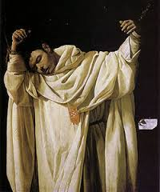
Francisco de Zurbarán, St. Serapion, 1628, oil on canvas. Baroque

Slide 4
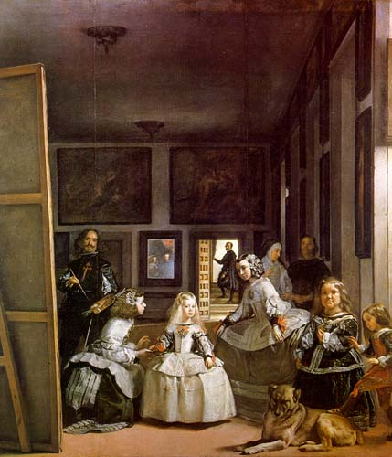
Diego Velázquez, The Maids of Honor (Las Meninas), 1656, oil on canvas. Baroque

Slide 5
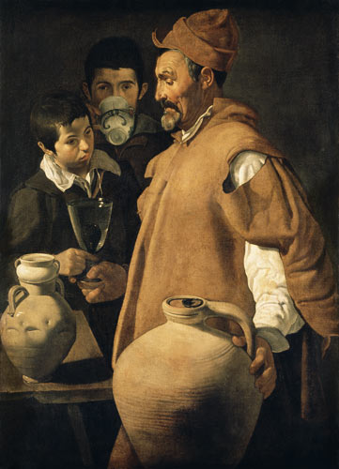
Diego Velázquez, The Water Carrier of Seville, c. 1619 oil on canvas. Baroque

Slide 6
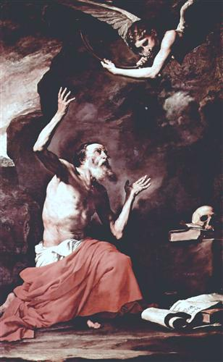
Jusepe de Ribera, St. Jerome and the Angel of Judgment, 1626, oil on canvas. Baroque

Slide 7
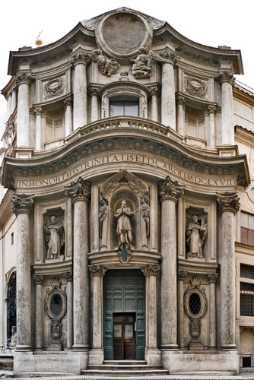
Francesco Borromini, façade of San Carlo alle Quattro Fontane, Rome, c. 1665 Baroque

Slide 8
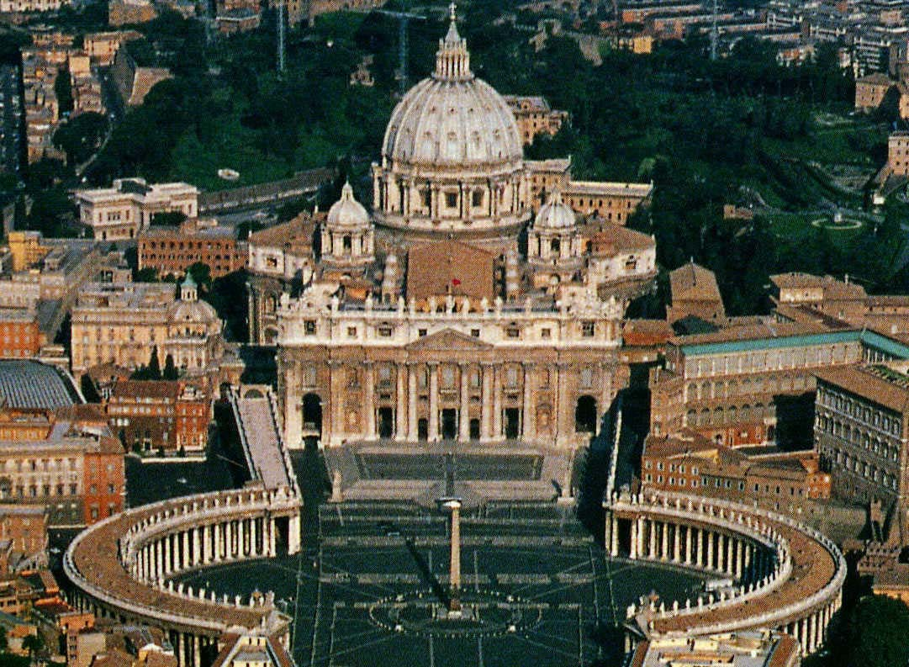
New St. Peter’s, Rome. Nave and façade by Carlo Maderno, 1607–15; colonnade by Gianlorenzo Bernini, designed 1657. Baroque

Slide 9
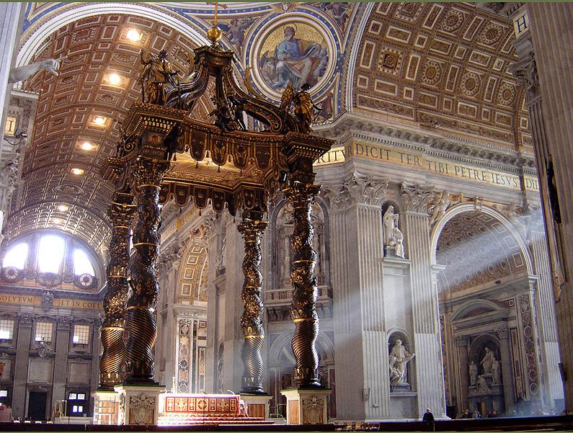
Gianlorenzo Bernini 1624-1633, gilt bronze, 100' high. Chair of Peter shrine, 1657-1666 Baroque

Slide 10
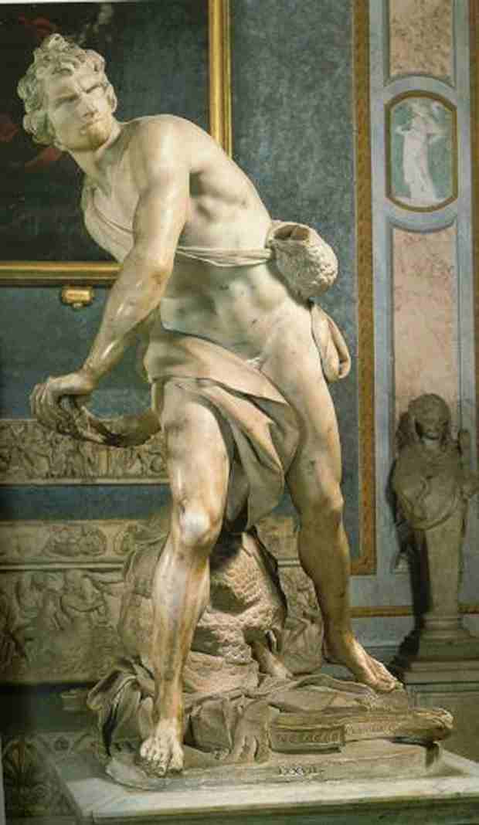
Gianlorenzo Bernini, David, 1623, marble Baroque

Slide 11
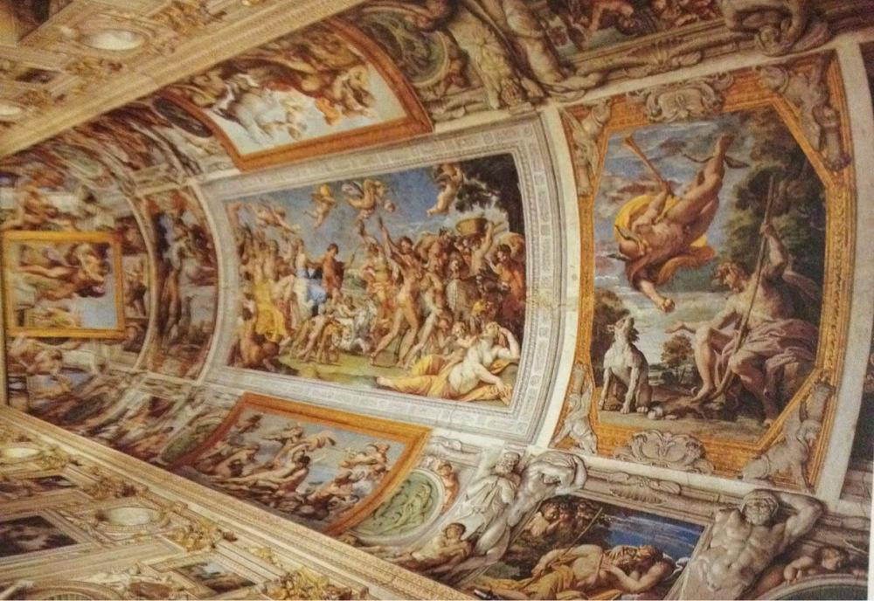
Annibale Carracci, Ceiling of Gallery, Palazzo Farnese, Rome, 1597–1601, fresco. Baroque

Slide 12
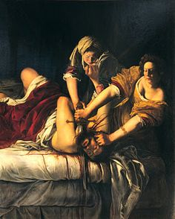
Artemisia Gentileschi, Judith and Her Maidservant with the Head of Holofernes, c. 1625, oil on canvas. Baroque

Slide 13
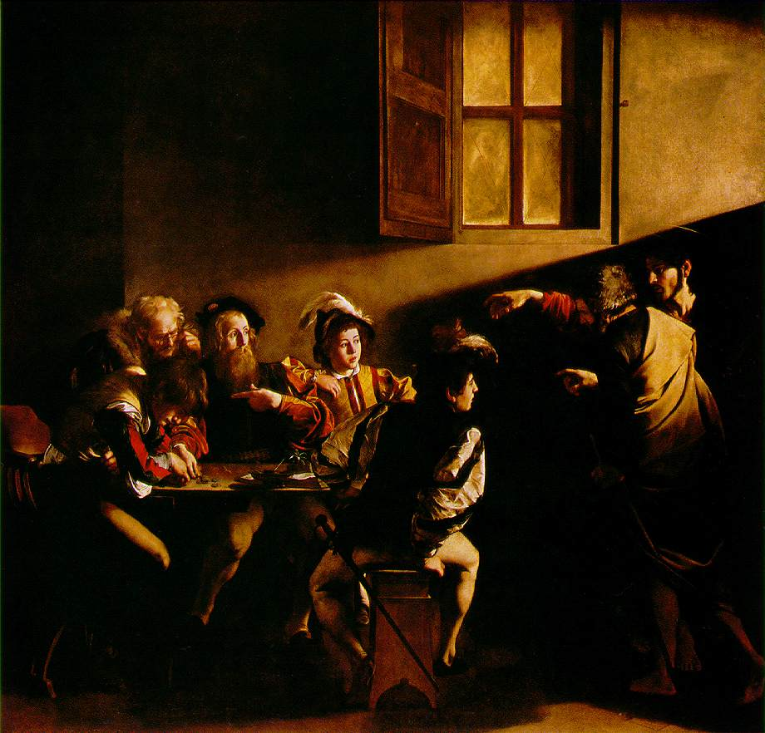
Caravaggio, The Calling of St. Matthew, Contarelli Chapel, church of San Luigi dei Francesi, Rome, 1599–1600, oil on canvas. Baroque

Slide 14
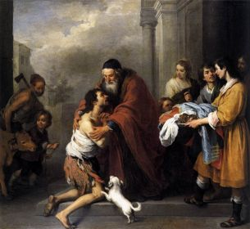
Bartolomé Esteban Murillo, Return of the Prodigal Son, 1667/1670, oil on canvas

Slide 15
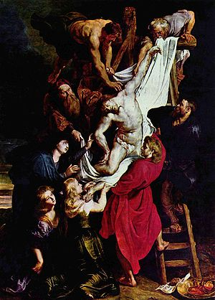
Dutch artist, Peter Paul Reubens. Descent From the Cross (1612-1614 Baroque

Slide 16
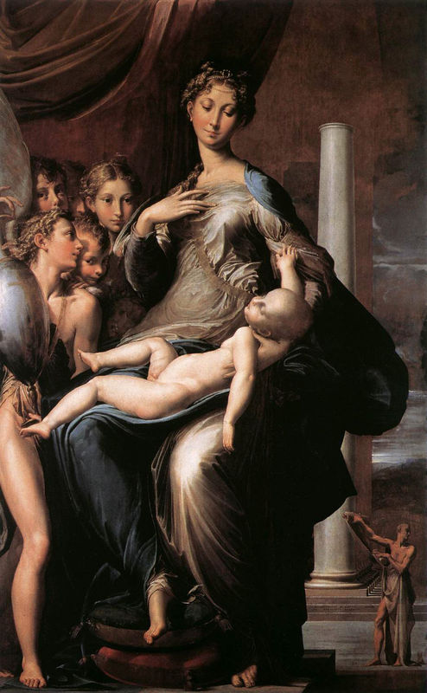
Madonna with the Long Neck, by Parmigiainino, 1534-1540 Mannerism

Slide 17
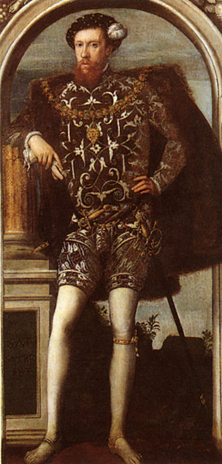
Henry Howard, Earl of Surrey. Portrait., 1546, artist unknown. Mannerism

Slide 18
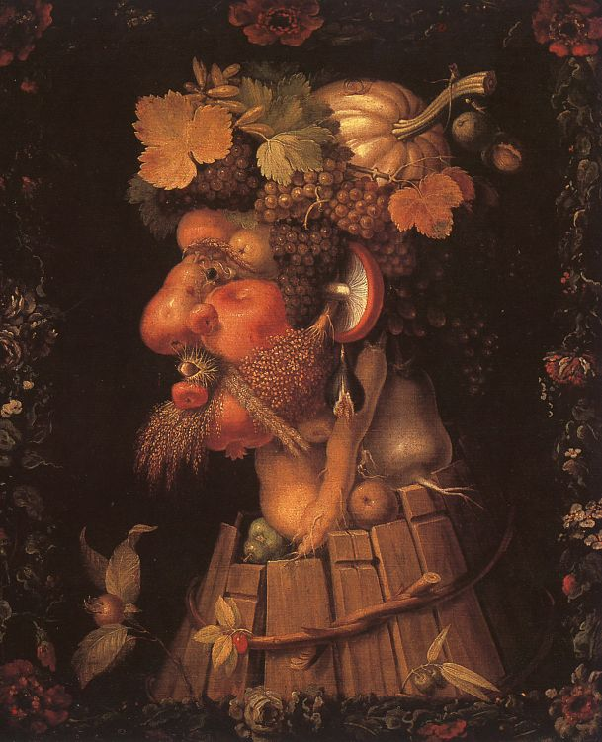
Giuseppe Arcimboldo, Autumn, 1573, oil on canvas Mannerism

Slide 19
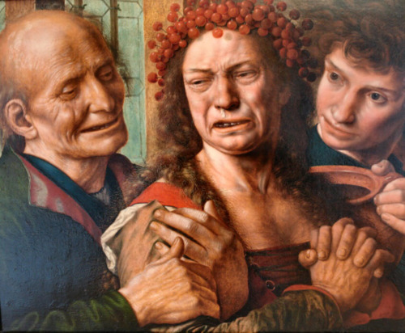
Jan Sanders van Hemessen, The Tearful Bride, C. 1540. oil on canvas Mannerism

Slide 20
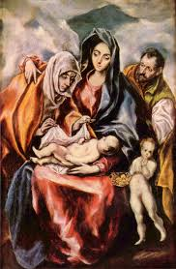
El Greco, The Holy Family with St. Anne and the Young St. John the Baptist Mannerism

Slide 21
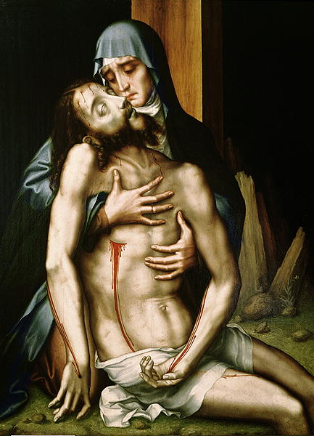
Luis de Morales, Pieta, mid 16th-century Mannerism

Slide 22
I. Mannerism
Italian word for “style”
Followed the ______ ________________ and preceded the__________
period.
3. Mannerist composition were full of:
a)
b)
c)
d)
e)

Slide 23
II. The Church and Mannerism
The Church disdained (hated) Mannerism because:
a) it was too ______________________
b) it was viewed as ____________ & ____________ because…
c) Mannerists posed their figures in ___________ _________.
d) The Church wanted art that was _____________for the viewer to
understand.

Slide 24
III. Baroque - Background
Art of the ____ _________ is traditionally referred to as Baroque.
Word is derived from the Portuguese & Italian words “barocco” meaning _____________________________.
Some criticized this form of art and architecture, arguing it lacked the ___________ & ______________of High Renaissance art.
It was viewed as overly _______________ &________________.

Slide 25
IV. Influence of the Catholic Church and Historical Context
The Church responded to the Protestant Reformation with the
________________ ____________________.
At one of the three sessions of the Council of Trent, discussion focused on using art to:
a)
b)
c)
d)
3. For the reasons above, Baroque art is __________________________________

Slide 26
V. Characteristics of Baroque Art
1.
2.
3.
4.

Slide 27
5.
6.
7.

Slide 28
VI. Baroque Architecture
“New” St. Peter’s Basilica
a. 17th century popes sought to restore ___________________
and reassert the power of the _________ and the ___________.
b. Remodeling of the Basilica was done to serve as __________
_____________________________and the _______________
__________________________________.
c. A grander design was needed to draw________________and
reassert __________ _______________.

Slide 29
VII. Areas of Prominence
Baroque originated in ________.
a) Major patrons = _________ & ___________
2. Mainly in ______________ Europe.
Especially in Catholic countries, such as ___________, where artists
continued to____________________________________________.
Not as predominant in ________________ countries.
a) in these countries artists________________________________
_________________________________________________________

